Slide 1
Topic for Project: Mother Dairy

Slide 2
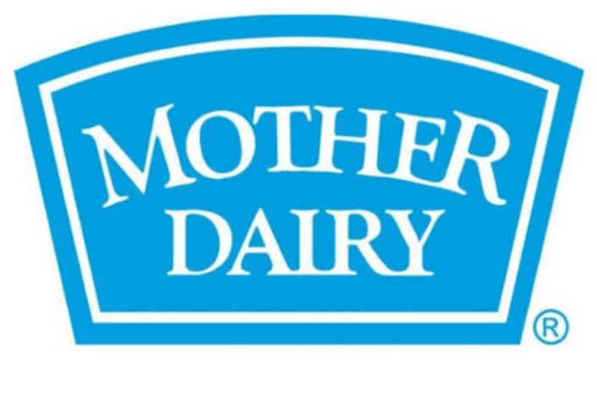
Research Brand Identity:
Brand logo:

Slide 3
Brand colours:Blue and White
Brand Tagline:”Happy Food, Happy People”
Brand’s website:https//www.motherdairy.com

Slide 4
Study of the Mother Dairy:
The founder of Mother Dairy is “Siddant Juneja”.
Today Mother Dairy manufactures, markets and sells milk and milk products including caltured products,ice creams, paneer and gee under the Mother Dairy brand.
The combination of blue and white colour in the logo unit denotes the dairy connect and also stands for purity, whole someness, natural and trust.
Mother Dairy was granted a permanent injunction against defendants using similarity to it’s own.

Slide 5
The vision ants, selling Vinay Milk,had employed a blue logo with white lettering and packaging which blatantly copied Mother Dairy’s protected and registered marks.
Mission and vission of Mother Dairy
Mission: Mother Dairy’s heritage is instrinsically linked to the cooperative movement in India.
Vission: provide quality food and beverage to consumers at affordable prices while ensuring fair returns to the producers.

Slide 6
Competitors of Mother Dairy:
Mother Dairy is a leading brand of milk, dairy products,and fruits,and vegetables in India.It has a wide range of competitors, ranging from small-scale producers to global corporation.the top competitors of Mother Dairy include.
AkshayaKalpa
Godrej Agrovent
Dodla Dairy
Milk Mantra
Osam Dairy
Param Milk Foods.

Slide 8
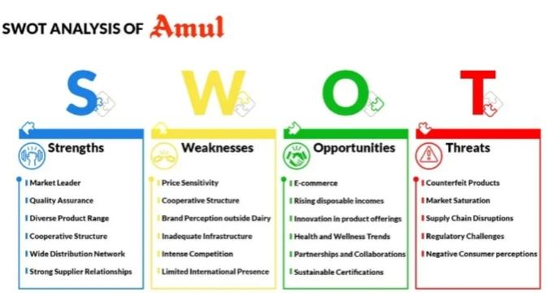
Competitor Analysis of Mother Dairy: Mother Dairy is a leading brand of milk, during products, fruits,and vegetables in India.It has a wide range of competitors, ranging from small-scale producers to global corporation.
Competitor 1:Amul
Amul is a leading India dairy brand owned by Gujarat coorporative Milk Marketing Federation Ltd. It is one of Mother Dairy’s closest competitors with a large market.

Slide 9
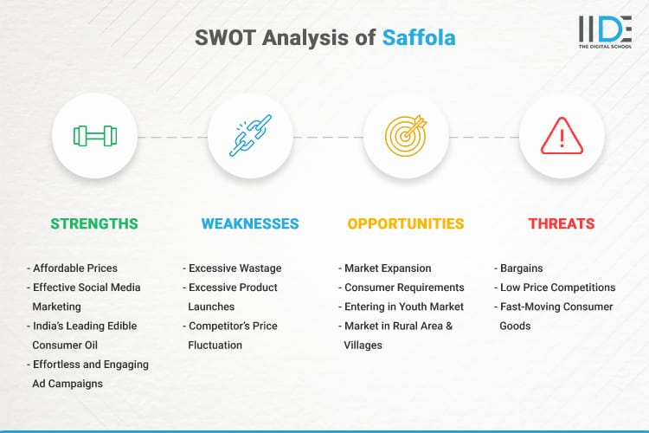
Competitor 2:Saffola
Saffola is an Indian fresh fruits and vegetables brand owned by Mother Dairy.It is a major competitor for Mother Dairy in the Indian market.

Slide 10
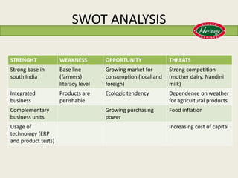
Competitor 3:Heritage Foods
Heritage Foods is an Indian food products corporation.It owned the dairy product brand Heritage and is a major competitor for Mother Dairy in the Indian market.

Slide 11
Topic of project: Mother Dairy

Slide 12
Mother Dairy: Buyer’s/Audience Persona
Target audience can be based on demographic information (age, gender, identity, location), psychographic information (aspirations, concerns, values) or behaviour (likely to buy online). Target audience are often broad and varied,So audience segmentation can help deliver a more personalized and effective message.Pshychographic segmentation “divides buyers into different segments based on internal characteristics-personality, values, beliefs, lifestyle, attitudes,interests,and social class.So you can market accordingly.

Slide 14
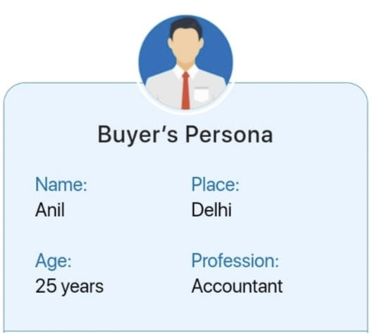
The target customers of Mother Dairy include ‘Middle and upper-middle-class families.They are of varied age groups as Mother Dairy has a variety of products catering needs of young children to adults.
Motivation
Fresh,local dairy products.
Quality,and hygien in food.
Affordable,nutritious options.
Health-focused choices.
Local taste preference.

Slide 15
Digital Marketing Project Phase 2

Slide 16
SEO AND KEYWORD RESEARCH

Slide 17
SEO AUDIT :
KEYWORD ANALYSIS :
Identify the primary keywords relevant to the dairy industry and Mother Dairy's products.
Analyze keyword rankings, search volume, and competition.
Ensure the website is targeting the right keywords in its content.

Slide 18
ON-PAGE SEO: Check title tags, meta descriptions, header tags, and keyword usage on their pages.
CONTENTQUALITY : Assess the quality and uniqueness of their content.
BACKLINKS : Examine the backlink profile to ensure they are from authoritative sources.
SITE STRUCTURE : Review the site's navigation and URL structure for user-friendliness.

Slide 19
PAGE SPEED : Check for page load times and mobile-friendliness.
TECHNICAL SEO : Ensure proper indexing, sitemaps, and schema markup.
MOBILEOPTIMIZATION : Assess how well the site performs on mobile devices.
LOCAL SEO : If applicable, review their local SEO efforts.

Slide 20
RESEARCH OBJECTIVES :
PRODUCT DEVELOPMENT : Researching and developing new dairy products or improving existing ones to meet consumer preferences and nutritional needs.
QUALITY CONTROL : Researching methods to ensure the quality and safety of dairy products from procurement to production and distribution.

Slide 21
SUSTAINABILITY : Researching sustainable practices in dairy farming, processing, and distribution to minimize environmental impact.
SUPPLY CHAIN EFFICIENCY : Researching ways to optimize the supply chain for efficiency and cost-effectiveness. MARKETRESEARCH : Understanding consumer preferences, market trends, and competitive analysis to guide product offerings and marketing strategies.

Slide 22
BRAINSTORM SEED KEYWORD : These are the some of the keywords of mother dairy
"Mother Dairy products"
"Dairy products in India"
"Milk and dairy items"
"Mother Dairy ice cream"
"Milk procurement process"
"Sustainability in dairy farming"
"Mother Dairy outlets"
"Dairy industry in India"
"Dairy farming practices"
"Mother Dairy quality control"

Slide 23
Long-tail keywords can be very effective for niche businesses like Mother Dairy. Here are some long-tail keyword ideas related to Mother Dairy: "Fresh milk delivery service in Delhi" "Mother Dairy flavored yogurt options" "Where to buy Mother Dairy paneer in Mumbai" "Mother Dairy ghee benefits for cooking" "Mother Dairy organic milk price per liter" "Is Mother Dairy milk homogenized?" "Mother Dairy's eco-friendly packaging" "Mother Dairy probiotic dahi for digestion" "Low-fat Mother Dairy milk benefits" "Mother Dairy buttermilk recipes" These long-tail keywords are more specific and target potential customers looking for detailed information about Mother Dairy's products, services, and benefits. They can help improve your SEO and content strategy by attracting more qualified and interested visitors to your website.

Slide 24
"Mother Dairy probiotic dahi for digestion" "Low-fat Mother Dairy milk benefits" "Mother Dairy buttermilk recipes"
These long-tail keywords are more specific and target potential customers looking for detailed information about Mother Dairy's products, services, and benefits. They can help improve your SEO and content strategy by attracting more qualified and interested visitors to your website.

Slide 25
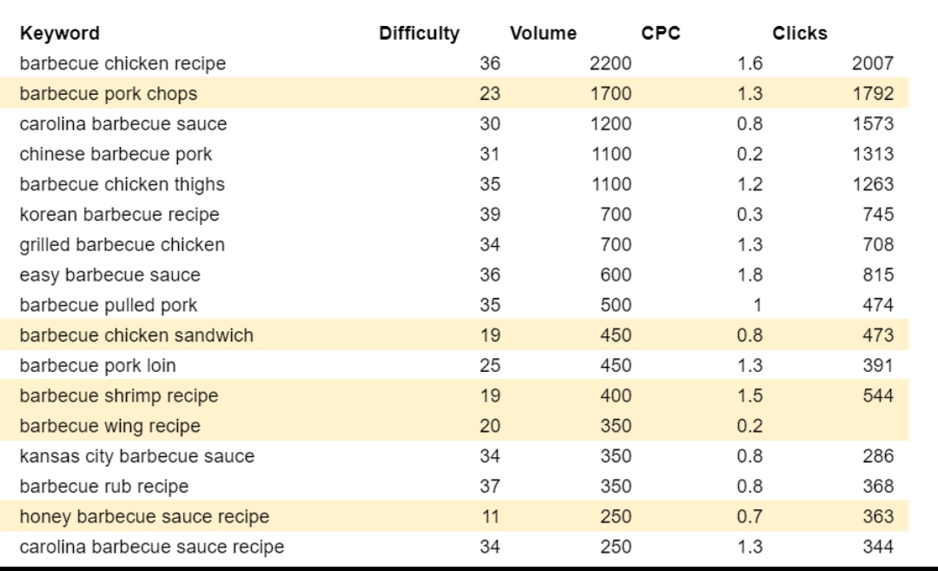

Slide 26
ON-PAGE OPTIMIZATION :
KEYWORD RESEARCH :
Identify relevant keywords related to Mother Dairy's products and services.
CONTENT QUALITY :
Create high-quality, informative, and engaging content about Mother Dairy's products and offerings.
TITLE TAGS :
Optimize title tags for each page with relevant keywords and a compelling description

Slide 27
META DESCRIPTIONS : Write unique and descriptive meta descriptions for each page.
HEADER TAGS : Use header tags (H1, H2, H3, etc.) to structure your content and include target keywords.
URL STRUCTURE : Create clean and descriptive URLs that include relevant keywords.

Slide 28
IMAGE OPTIMIZATION : Compress and optimize images for fast loading and include descriptive alt text.
INTERNAL LINKING : Link to related pages within the site to improve navigation and user experience.
MOBILE OPTIMIZATION : Ensure that the website is mobile-responsive for users on smartphones and tablets.

Slide 29
PAGE SPEED : Optimize page load times to improve user experience and SEO ranking.
SCHEMA MARKUP : Implement structured data (schema markup) to provide search engines with additional information about products and services.
USER EXPERIENCE : Design the website for a positive user experience, including easy navigation and clear calls to action.

Slide 30
SECURITY : Ensure the website is secure with HTTPS to boost search engine ranking and user trust.
CONTENT UPDATES : Regularly update and refresh content to keep it relevant and informative.
LOCAL SEO :
If Mother Dairy has physical locations or outlets, optimize for local search by creating Google My Business profiles and ensuring accurate contact information.

Slide 31
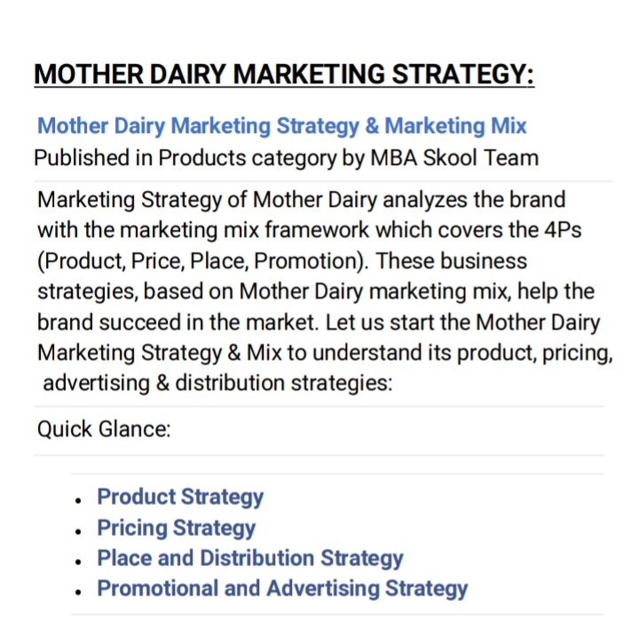

Slide 32
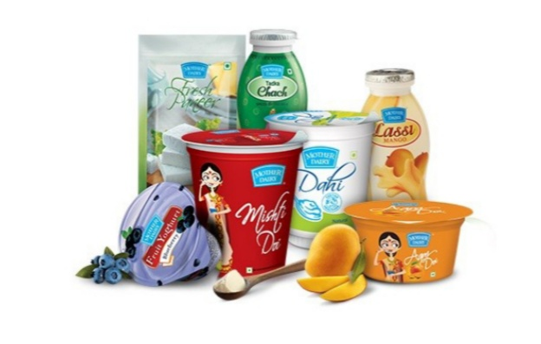

Slide 33
